Slide 1

Python and R for ETL
By Maz

Slide 2

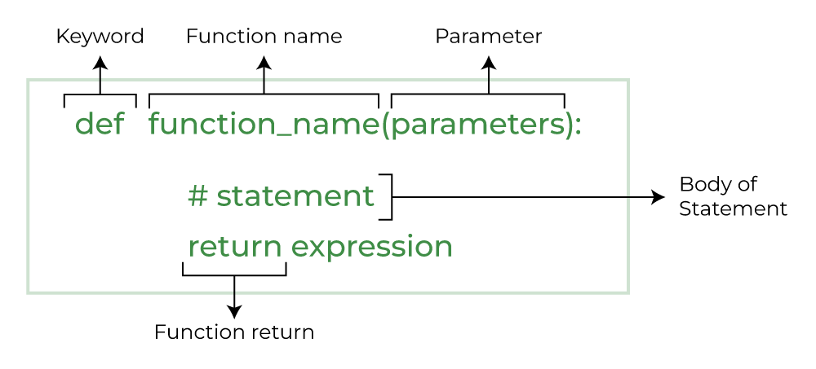
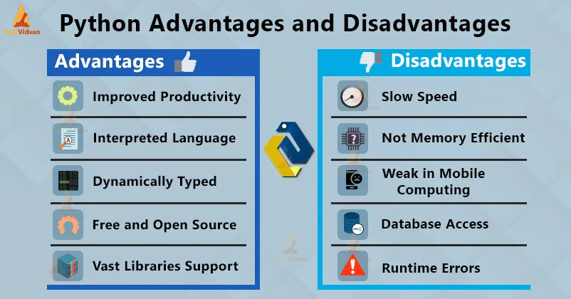
Python
Cost | Python is free and open source
Speed | Python is 5.8 times faster than R in some instances.
Analysis & ETL function | Python is a procedural language, so the program code is written as a procedure of step-by-step instructions in a sequence where the user has to specify “what to do” and “how to do”. Python enables integration with other programming languages and software development tools. Code written in blocks are functions to carry out a specified task. Python has user-defined functions and built-in pre-defined functions. ETL lets you activate the data transfer between systems and is an essential part of your Data stack processes. Python has a range of library support (e.g. Django for web development, etc.), along with many developer tools, such as Jupyter Notebooks (JN) and IDEs, like PyCharm. Pandas is a popular, widely used Python library for data science, along with NumPy in matplotlib. It also has various Python ETL(petl) tools: that act as frameworks, libraries, and software, which include; Apache Airflow describing relationships between tasks using directed acyclic graphs (DAG) to; Luigi, Pandas, Beautiful Soup, Odo, Bonobo, Petl, pygrametl to name a few.
Alternatives | NodeJS, Java, Scala, Rust, Ruby, Elixir, Golang, Kotlin PHP.
Everyday use cases | Python is used not only for tasks such as developing websites and software for task automation but also for data analysis/visualisation and machine learning. Data analysts use Python to describe and categorise data currently existing by exploratory data analysis, which can involve profiling the data, visualising results, and creating observations for further analysis.

Slide 3
Pythons cleaning data process
The process of identifying and correcting (or removing) corrupt or inaccurate records from a record set, table, or database is known as data cleaning or cleansing. It entails determining which parts of the data are incomplete, incorrect, inaccurate, or irrelevant and then replacing, modifying, or deleting the dirty or coarse data.
Python comes with a number of packages that can be used to clean up data. The two most widely used libraries are numpy and pandas.
For Python programmers, Pandas is an extremely potent data processing tool. It offers a wide range of functionality to handle different file formats from numerous data sources. For data scientists who are involved in data cleansing and analysis, the Pandas library is especially helpful.

Slide 4
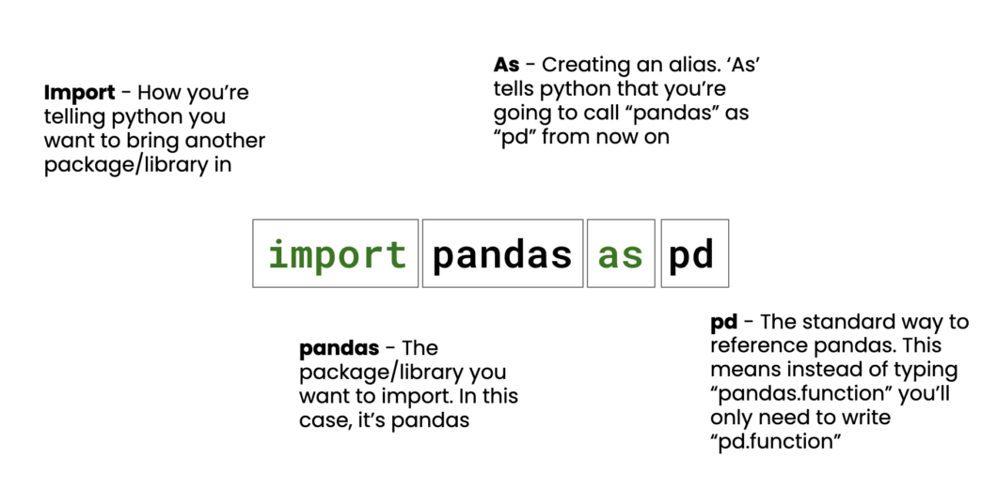
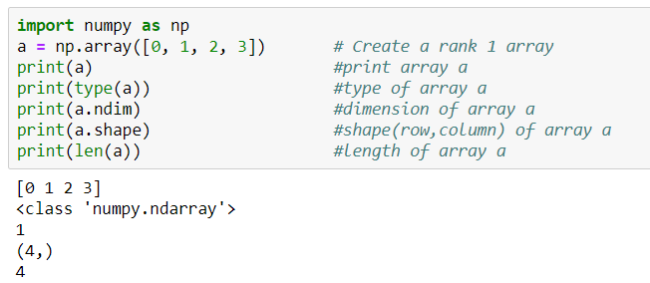
Importing the needed libraries
The only thing to do in this phase is import the necessary libraries, which are CSV, Numpy, and Pandas. In terms of data science, these libraries are essential.

Slide 5
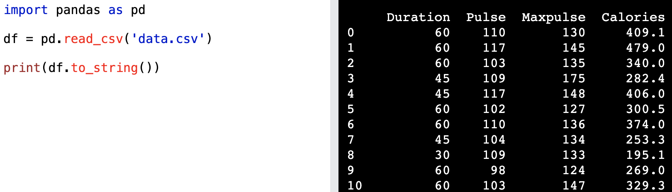
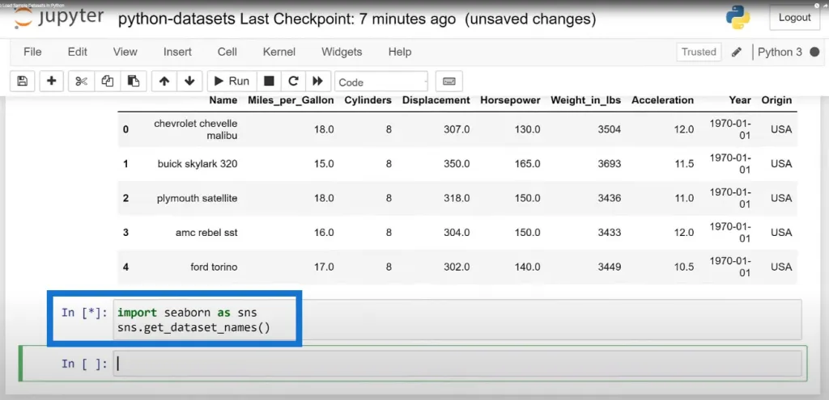
Loading data set
The second step is to display the data set after retrieving it from a separate source.
The data-set must be obtained from a different source for this stage

Slide 6
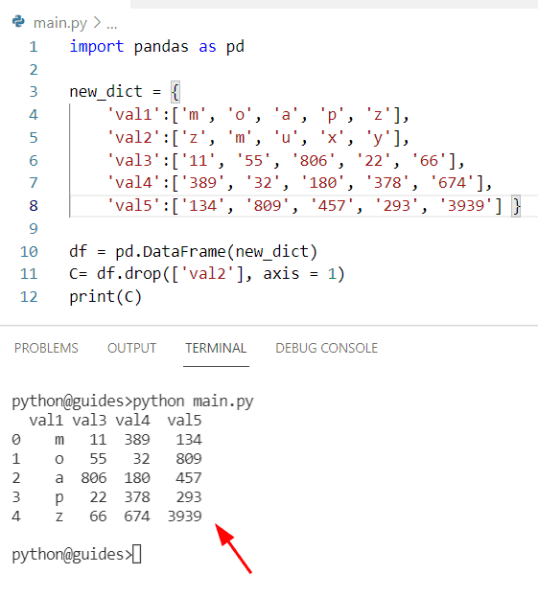
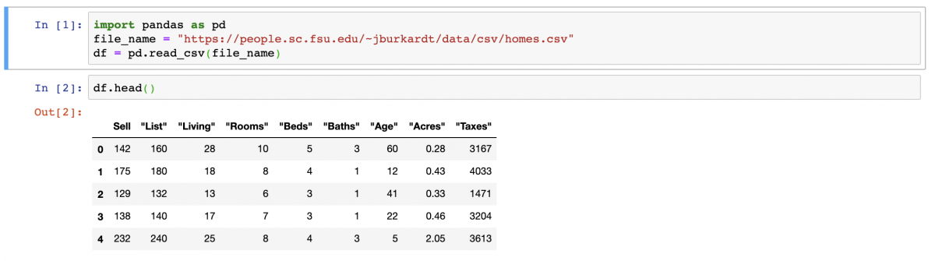
Eliminating the inactive or unnecessary columns
The code for this stage, which entails deleting unnecessary columns like cp, fbs, thalach, and many more, is largely self-explanatory.

Slide 7
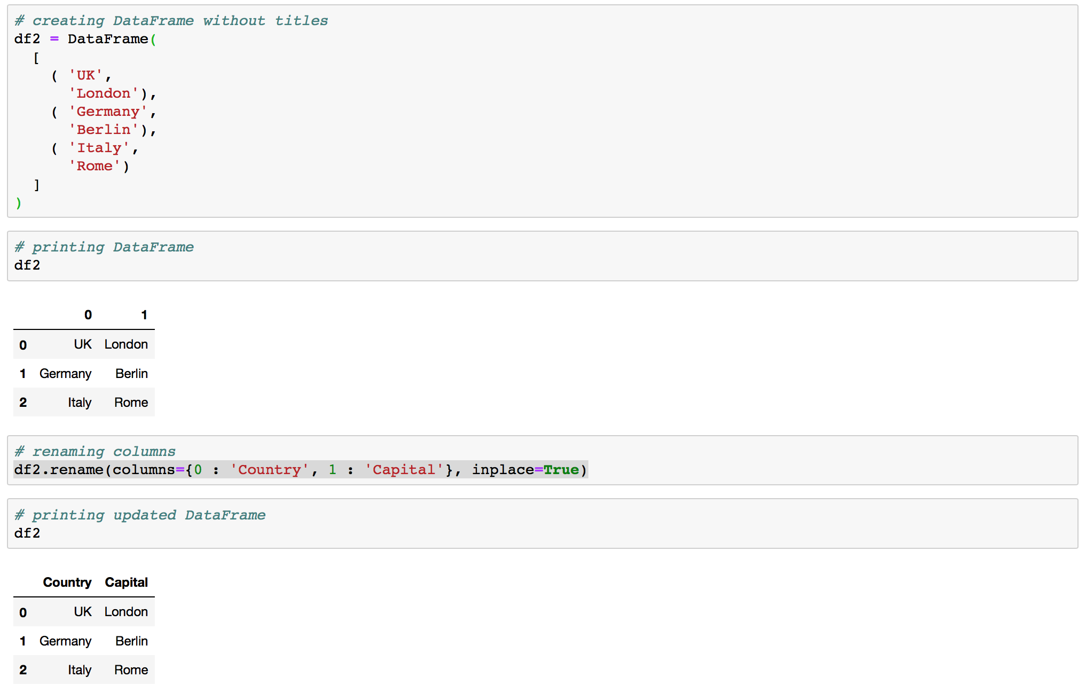
Renaming the columns to better suit our needs.
As a result of many column titles being unclear and difficult to grasp, this phase entails renaming the columns.

Slide 8
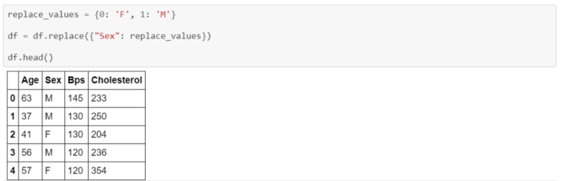
Changing the value of the rows.
This step entails replacing the missing values or making the values more readable. For example, the Sex field in this example has the values 1 and 0 for Male and 0 for Female, but it frequently seems ambiguous to a third party; therefore, it would be a good idea to change the value to one that is clearer.

Slide 9
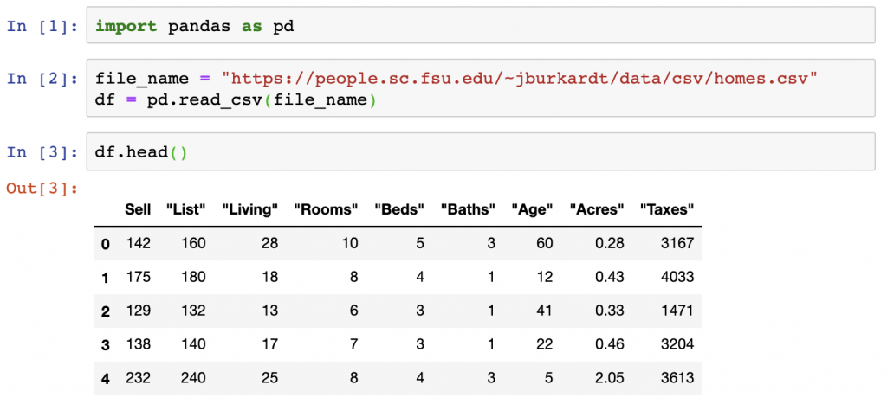
Rename columns
df = pd.read_csv(df, header=None)
feature_map = {0: 'column1',
1: 'column2',
2: 'column3'}
df.rename(columns=feature_map, inplace=True)

Slide 10
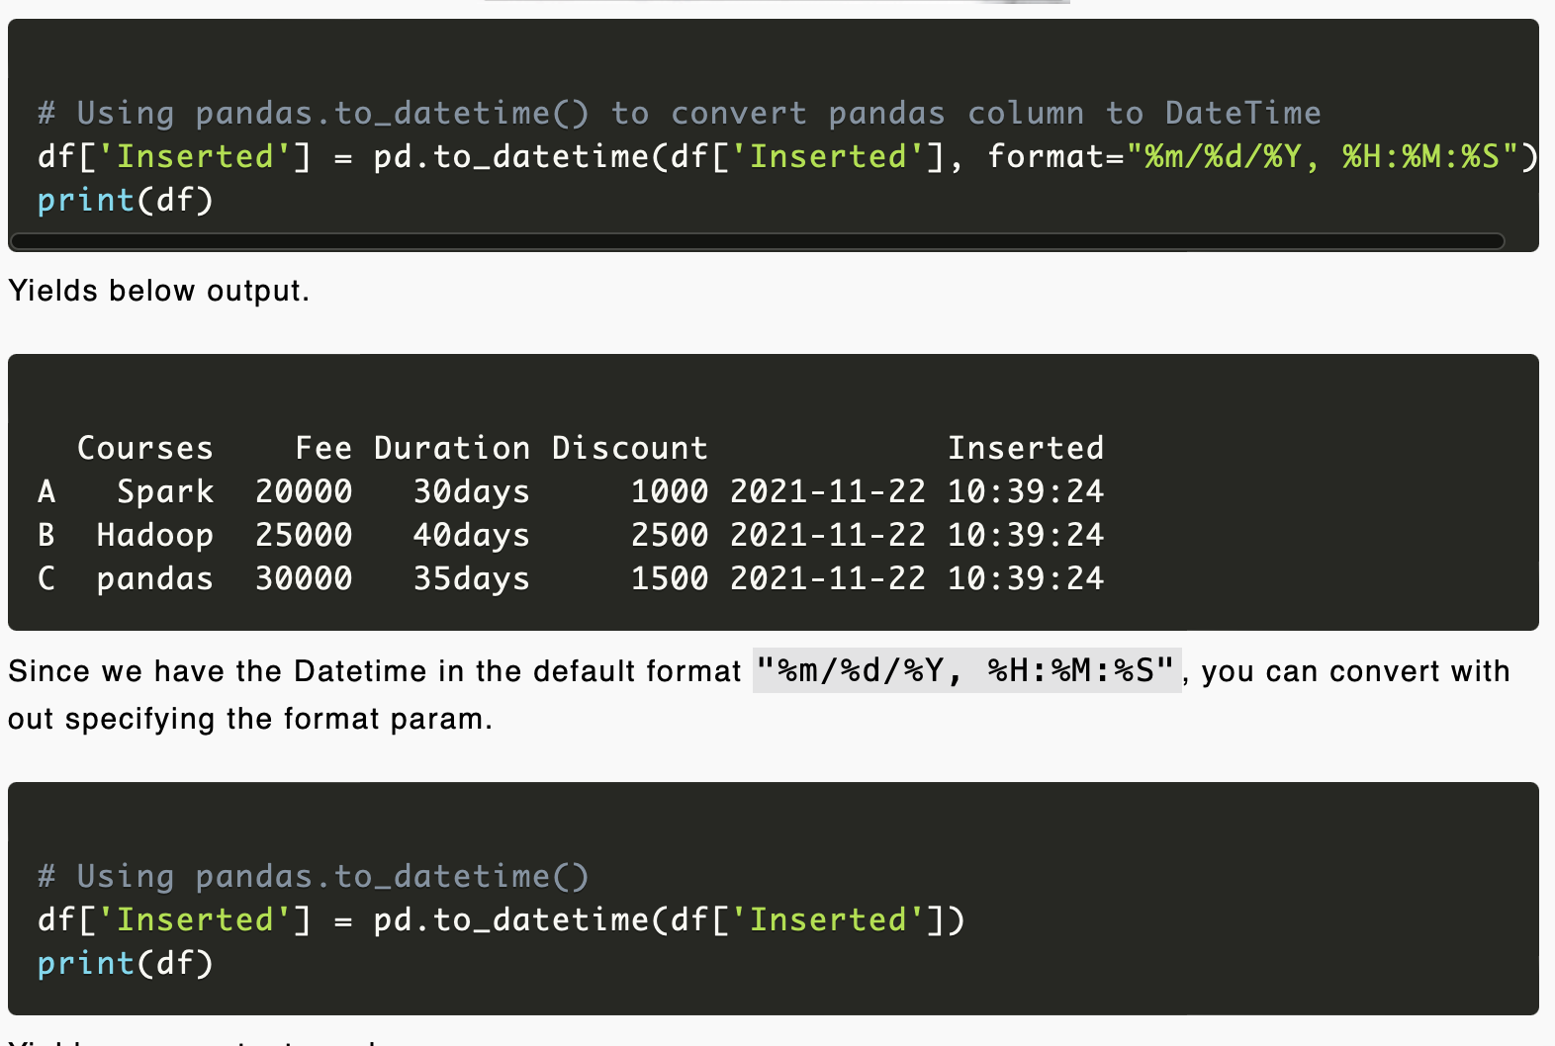
Cast a column to datetime
df['column1'] = pd.to_datetime(df['column1'])

Slide 11
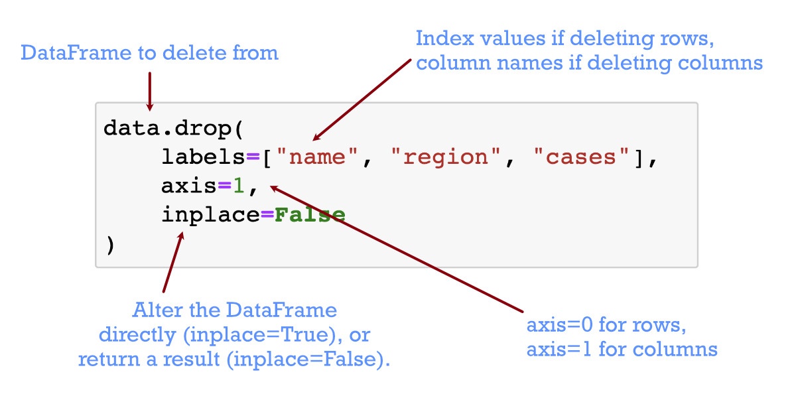
Drop a row or column
df = df.drop(['column1','column2'], axis='columns')

Slide 12
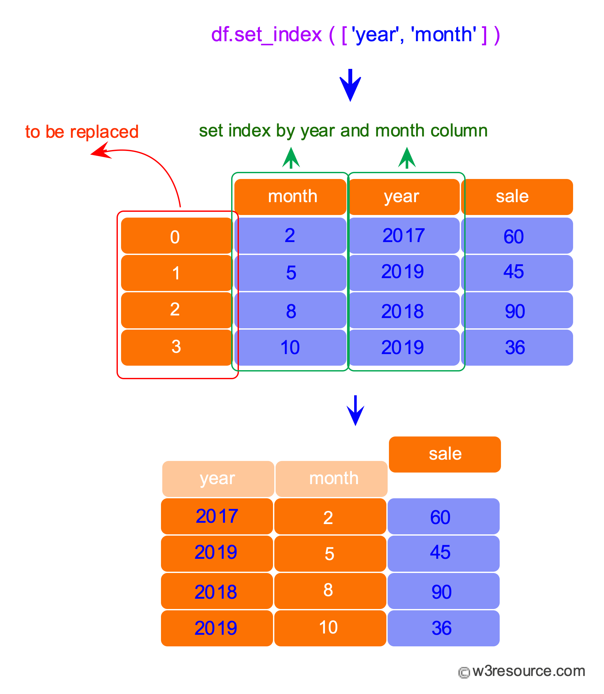
Set a column as the index
df = df.set_index('column1')

Slide 13
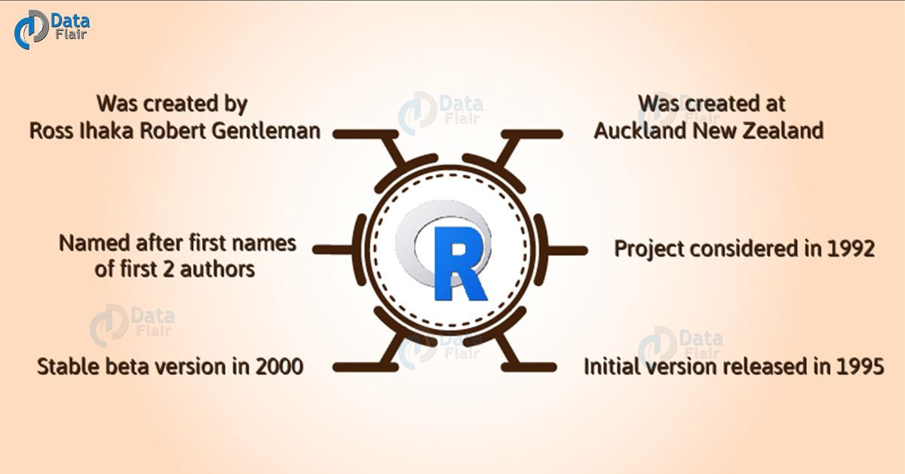
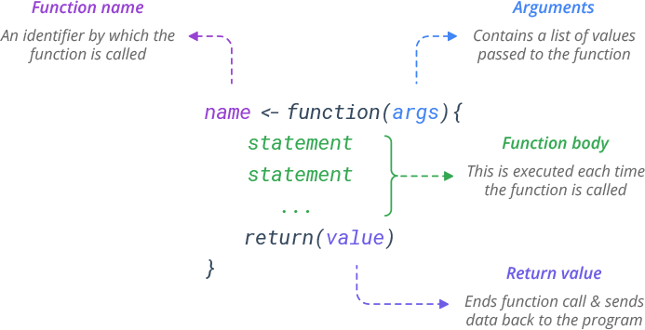
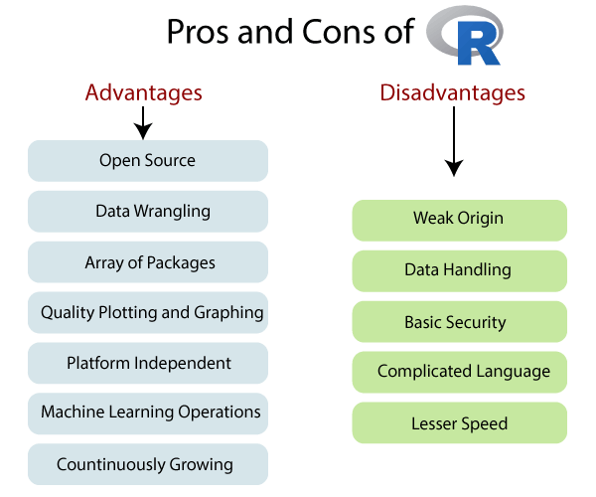
R
Cost | The official R software is open source and free, but RStudio Workbench Standard is $995 yearly for the first 20 users.
Speed | Longer code is required for even simple processes with R. Python is 5.8 times faster than R in some instances.
Analysis & ETL function | R is a procedural language, so the program code is written as a procedure of step-by-step instructions in a sequence where the user has to specify “what to do” and “how to do”. R has a built-in function to directly call in the program by users such as sq(), mean(), max() and user-defined function allowing you to write your own function. R has a lot of support for all sorts of sophisticated and obscure statistical libraries with packages that extend R’s base functionality, including tidyverse to transform, visualize and streamline your workflow; ggplot2, enhancing R’s visualization capabilities; and TensorFlow, extending R’s utility into machine learning. Rstudio for R is used for development. R can be run in Jupyter Notebooks (JN) with the right know-how. Although there are paid ETL tools for R, such as Panoply, Blendo and Stitch. There are also plenty of open-source R ETLs such as Apache Spark, Pentaho Kettle etc.
Alternatives | PythonPython is a general-purpose programming language; whilst RustRust is a systems programming language ; then MATLAB can analyse data and develop algorithms and create models; then you have GolangGo, SAS, RubyRuby, JuliaJulia and JavaJava.
Everyday use cases | R is a programming language made by statisticians for statistics mainly with data: were its widely used by; business analysts, data analysts, data scientists, and scientists; as a language. for statistical computing and data visualizations.

Slide 14
R stages in data cleaning
R is an excellent tool for handling data. Since statistics is the language of choice for many data scientists and social scientists, packages like tidyverse make difficult data processing practically painless.
The stages of cleaning data with R includes;
Become familiar with the data set.
Verify for structural flaws
Look for data anomalies.
Make a decision regarding missing values.
Versions and modifications to document data

Slide 15
Become familiar with the data set.
In the first stage of cleaning with R, you need prior to performing actual data cleaning, it is essential to thoroughly understand your dataset, including the file sizes and data kinds. Nothing is more unpleasant than beginning your analysis only to realise that a key feature is cluttered with noise or that you are running low on RAM.

Slide 16
Check for structural errors
We will assess the data frame for structural errors now that we are familiar with the data. These include data entry mistakes such incorrect data types, non-unique ID numbers, incorrectly labelled variables, and inconsistent string formatting. Include additional procedures in your data cleansing to handle the peculiarities if your dataset contains more structural pitfalls than those described here.
erroneous variable labels
incorrect data types
IDs that are not unique
inconsistent string values

Slide 17
Check for data irregularities
The dataset will then be examined for abnormalities, including accuracy issues like incorrect values and outliers. These two mistakes are typical in untidy data frames, but you should be mindful of any abnormalities unique to your own data.
incorrect values
Outliers
Get rid of the observation
Winsorize
Avoid action.

Slide 18
Decide how to deal with missing values
Get rid of the variable
Take the observation away
Put the omitted value in.
Utilize missing value-supporting algorithms

Slide 19
Document data versions and changes made
An essential component of effective data cleaning is clear documentation. What motivated you to change what you did? What method did you use? In what form did you use the raw data? All of these are significant inquiries that require responses from you. Your R project's documentation can be smoothly incorporated using tools like R Markdown and RPubs.

Slide 20
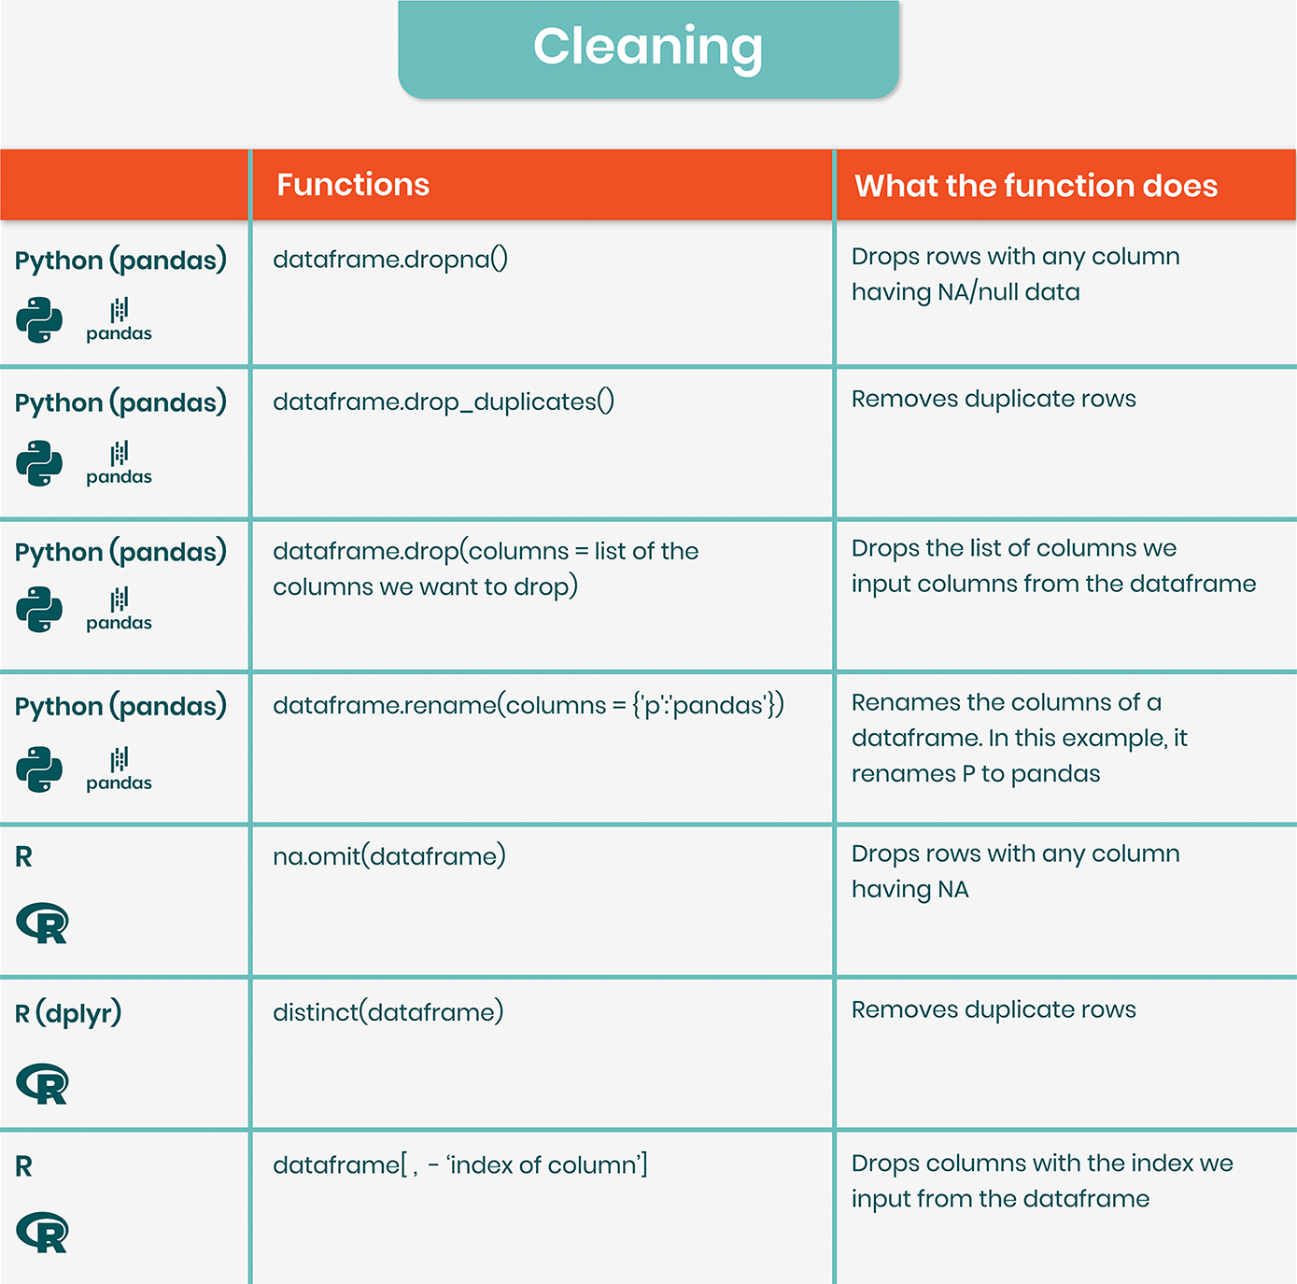
Python and R
While Python and R can both do many of the same data-related tasks, they each have certain advantages. You might want to give the language that excels at certain jobs priority if you know you'll be spending a lot of time on specific data-related tasks.

Slide 21
Python and R comparison
Both R and Python are programming-required tools for data analysis. The distinction is that whereas scientific computing and data analysis are merely an application branch of Python, R is only utilised in the field of data analysis. Python can also be used to create web pages, games, system backends, and perform some maintenance and operation tasks.
The field of data analysis is currently seeing Python catch up to R. In some areas, including text mining and machine learning, it has outperformed R. But R continues to hold a competitive advantage in the statistical community. Some of the features of R have been modelled in many places by the development of Python for data analysis. Therefore, I advise you to start learning using Python if you are still a beginner.
R and Python are both simple to learn. However, learning both at once will be extremely perplexing because they are very similar in many ways. Therefore, it is advised against learning them simultaneously. Start learning the other one just after you have mastered the first.

Slide 22
Loading Data in Python and R
When loading into the variable in both languages, the only major distinction is that in Python, access to Dataframes requires the import of the Pandas package. Using the reader library function read csv() instead of the standard R function read.csv() in R provides the advantages of being faster and consistently interpreting data types.
Both R and Python provide dataframes, which are two-dimensional arrays (matrices) in which each column may have a different datatype. They can be compared to the programming equivalent of a data table or a spreadsheet. This step concludes with the CSV

Slide 23
Functions of Python and R comparison
Once more, it is clear that despite a few minor syntax variations, the two languages are remarkably similar.
It's important to point out that Python is more object-oriented in this situation because head is a method on the dataframe object rather than a distinct head function in R.
As we begin to analyse these languages, we will notice that this is a recurring feature. R is more functional, while Python is more object-oriented.

Slide 24
Python and R comparison (Continued)
Python is more object-oriented, while R is more functional.
In Python, we use the main Python machine learning package, scikit-learn, to fit a k-means clustering model and get our cluster labels. We perform very similar methods to prepare the data that we used in R, except we use the get_numeric_data and dropna methods to remove non-numeric columns and columns with missing values. R is more functional, Python is more object-oriented. As we saw from functions like lm, predict, and others, R lets functions do most of the work. Contrast this to the LinearRegression class in Python, and the sample method on Dataframes. In terms of data analysis and data science, either approach works. R has more data analysis functionality built-in, Python relies on packages.
In R, we could use the summary built-in function to examine summary statistics, but in Python, we had to import the statsmodels package. In R, the Dataframe is a built-in construct; however, in Python, it needs to be imported via the pandas package.

Slide 25
Python and R comparison (Continued)
Python has “main” packages for data analysis tasks, R has a larger ecosystem of small packages.
With Python, we can do linear regression, random forests, and more with the scikit-learn package. It offers a consistent API, and is well-maintained.
In R, we have a greater diversity of packages, but also greater fragmentation and less consistency (linear regression is a built-in, lm, randomForest is a separate package, etc).
R has more statistical support in general.
R was built as a statistical language, and it shows. statsmodels in Python and other packages provide decent coverage for statistical methods, but the R ecosystem is far larger.

Slide 26
Python and R comparison (Continued)
Non-statistical activities are typically easier to complete with Python.
Web scraping in Python is easier than in R because to well-maintained modules like BeautifulSoup and requests.
This also holds true for other jobs that we didn't examine in-depth, such as managing intricate workflows, deploying web servers, and storing to databases.
If you're mixing your data work with other types of programming activities, Python might be a better option because it's used across many sectors and programming disciplines.
However, because R was created with a focus on statistics, it offers certain benefits if you're interested in data and statistics.
The data analysis process in both has many similarities.
There are obvious similarities between the two.
Both the R and Python ecosystems continue to develop, and there are many obvious similarities between the two (for example, pandas Dataframes were inspired by R dataframes, and the rvest package by BeautifulSoup).
In fact, it's amazing how similar the syntax and methods are between the two languages for many typical jobs.

Slide 27
Python and R comparison (Continued)
Organizing and Cleaning Up Raw Data
Before finishing any analytical procedure on raw data, data cleaning must be done.
As with any endeavour, it's important to get off to a good start because if not, faulty data will probably bias the outcomes.
Understanding the dataset and file sizes is just the beginning of data cleaning, which also involves finding duplicates, outliers, missing data, incorrect data, and formatting problems.
Data cleansing R packages include:
Tidyr is a tool that recognises variables in datasets and carries out operations to gather, segregate, or distribute the data.
Sqldf is a package that enables R studio users to create SQL code.
Cleaner who discovers duplicates
RMarkdown is a programme that helps integrate documentation into projects, which aids in organising even if it isn't specifically a data-cleansing tool.

Slide 28
Python and R comparison (Continued)
Python also provides a number of packages that can help with data cleansing.
Popular choices comprise: To read, analyse, and write CSV data files into dataframes to carry out various cleaning activities, use the Pandas library.
For general data cleaning, NumPy, which is built to cope with arrays, is frequently combined with Pandas.
To identify places where the data is insufficient, distribution plots are made using the visualisation package Matplotlib.
When showing usable data, Seaborn, a different visualisation package built on top of Matplotlib, gives greater customization possibilities.
Speed is a drawback for each of these languages while cleaning data.
R often runs slower than Python since it keeps data in memory.
However, very huge data sets are frequently involved in data cleansing.
Python really has a disadvantage when evaluating huge volumes of data due to the absence of multithreading capability.

